Slide 1
PREPARE
HOW MANY MATHS WORDS CAN YOU MAKE USING THE LETTERS IN THE SCHOOL ADDRESS?
THE BURTON BOROUGH SCHOOL
AUDLEY AVENUE
NEWPORT
SHROPSHIRE

Slide 2
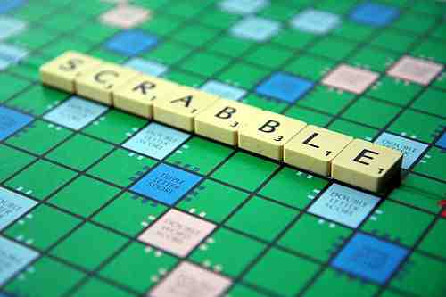
SHARE

Slide 3
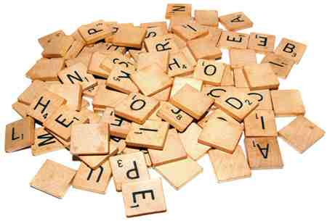
PRESENT HOW CAN YOU SCORE POINTS IN SCRABBLE?

Slide 4
CEMENT
CALCULATE HOW MANY POINTS YOU WOULD SCORE FOR EACH OF THESE WORDS
ISOSCELES
MATHEMATICS
PARALLEL
DIVIDE
MULTIPLY
PROBABILITY
AVERAGE
WORK OUT THE SCORE FOR SOME OF YOUR OWN WORDS

Slide 5
DO
WRITE AN EXPRESSION FOR EACH WORD AND CALCULATE THE SCORE
TATTOO
TOMORROW
POSSESS
DEFINITE
MILENNIUM
PROPAGANDA
QUESTIONNAIRE

Slide 6
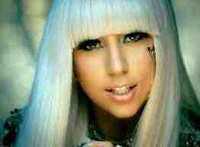
REVIEW
CAN YOU WORK OUT THESE FAMOUS POP ACTS FROM THEIR EXPRESSIONS
3a + d + 2g + l + y

Slide 7
REVIEW
CAN YOU WORK OUT THESE FAMOUS POP ACTS FROM THEIR EXPRESSIONS
E + 2i + 2l + m + 2t + x

Slide 8
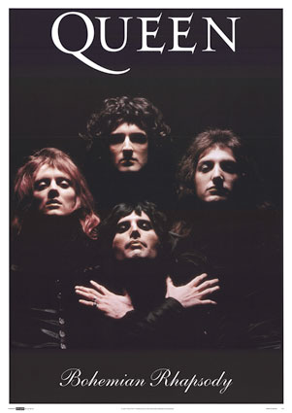
REVIEW
CAN YOU WORK OUT THESE FAMOUS POP ACTS FROM THEIR EXPRESSIONS
2e + n + q + u

Slide 9
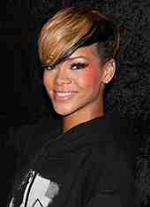
REVIEW
CAN YOU WORK OUT THESE FAMOUS POP ACTS FROM THEIR EXPRESSIONS
2a + h + i + 2n + r

Slide 10
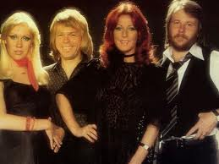
REVIEW
CAN YOU WORK OUT THESE FAMOUS POP ACTS FROM THEIR EXPRESSIONS
2a + 2b

Slide 11
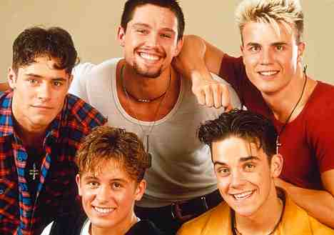
REVIEW
CAN YOU WORK OUT THESE FAMOUS POP ACTS FROM THEIR EXPRESSIONS
2a + e + h + k + 3t

Slide 12
