Slide 1
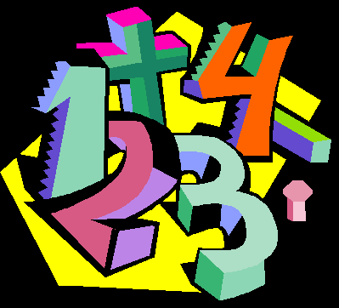
Mathematics Code Breaker
In the following expressions,  = 5,  = 3, ➢ = 10,  = 100. Substitute into each expression to get your answer. Then look at the table below to see which letter your answer represents. Fill that into the blanks underneath to reveal another HILARIOUS maths joke.
A | B | C | D | E | F | G | H | I | J | K | L | M | N | O | P | Q | R | S | T | U | V | W | X | Y | Z
0 | 1 | 2 | 3 | 4 | 5 | 6 | 7 | 8 | 9 | 10 | 11 | 12 | 13 | 14 | 15 | 16 | 17 | 18 | 19 | 20 | 21 | 22 | 23 | 24 | 25
$$\frac{\text{Ξ}}{10}$$
 + 5
➢ + 
13 - ➢
$$\frac{400}{\text{Ξ}}$$
$\frac{\text{¬}}{2}$ - 1
17 + 
➢ - 3
 - 3
 + ➢ + 6
5 – 1
2 – 1
3 + 4
2 ➢ - 3
$$\frac{9}{\text{Μ}}$$
$$\frac{\text{Ξ}}{\text{σ}} −6$$
$$\frac{\text{Ξ}}{10} −\text{¬}$$
4 
➢ – 2
4 – 1
$$\frac{\text{Ξ}}{\text{σ}} −2$$
3 – 11
6 
➢ – 
$$\frac{\text{Ξ}}{25}$$
 - 100
$$\frac{\text{¬}}{\text{σ}}$$
2 ➢ – 13
½ ➢ – 1
 ² + 8
$$\frac{\text{Ξ}}{{\text{¬}}^{2}}$$
2 ➢ - 1
 ÷ ➢ ÷ 
2 ➢ – 3
⬧ ² - 17
3(– 1)
?
2➢ - 2
⬧ ² – 1
➢ + 2
$\text{}$ – 88
² - 
7 - 2
➢ - 13
² + 3 
!!

