Slide 1


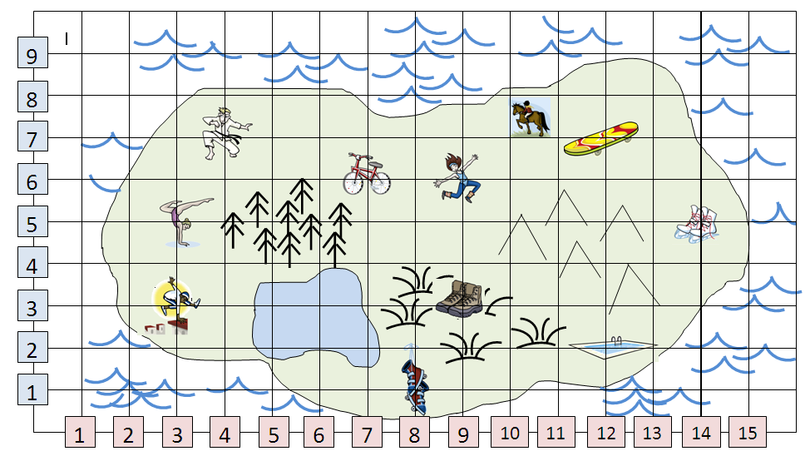
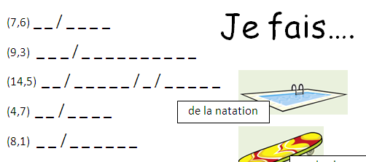



Prepare
Prepare
Present
Present
Share
Share
Cement
Cement
Do
Do
Review
Review
Prepare
Prepare
Present
Present
Share
Share
Cement
Cement
Do
Do
Review
Review
Lire
Qu’est-ce que tu fais?
mercredi le vingt-sept mars
Page: 32
Prepare
Find the co-ordinates (numeracy) on the treasure map to solve the puzzles!
exemple: (7,6) = du vélo
Parler
Challenge:
Écrire
Écouter
Notes:
8.4
1

Slide 2

(9,3) je fais des promenades
(12,7) je fais du skate
(8,1) je fais du roller
(12,2) je fais de la natation
(7,6) je fais du vélo
(3,5) je fais de la gymnastique
(10,7) je fais de l’équitation
(4,7) je fais du judo
(3,3) je fais du parkour
(9,6) je fais de la danse
(14,5) je fais du patin à glace
Why have I chosen these colours?

Slide 3


français
To achieve this, we’re going to:
Identify some activities which use the verb “faire”
Understand people talking about what they do.
Form some conversations about activities in different weather.
We are learning about:
Qu’est-ce que tu fais?
what do you do?
We are learning to:
Say what we do in different weather conditions
with opinions – Lv3
with reasons – Lv4
Self-manager
Independent Enquirer
PLTS: This lesson we are going to be:
Team Worker
Effective Participator
Creative Thinker
Reflective Learner
Notes:
3
3

Slide 4
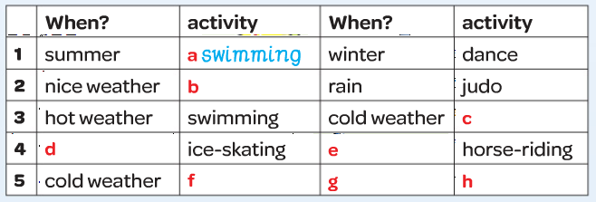
walking
roller skating
in winter
in summer
free running
it’s nice
skateboarding
Challenge
Person 5 gives a level 4 response.
Which opinions & reasons are used?
Write the FRENCH in your book
c’est génial
j’adore ça aussi

Slide 5
français
To achieve this, we’re going to:
Identify some activities which use the verb “faire”
Understand people talking about what they do.
Form some conversations about activities in different weather.
We are learning about:
Qu’est-ce que tu fais?
what do you do?
We are learning to:
Say what we do in different weather conditions
with opinions – Lv3
with reasons – Lv4
Self-manager
Independent Enquirer
Effective Participator
Team Worker
PLTS: This lesson we are going to be:
Team Worker
Creative Thinker
Effective Participator
Creative Thinker
Reflective Learner
Notes:
5
5

Slide 6
Jot down some opinions & reasons in your exercise book now.
How many can you get in 1 minute?
J’adore ça!
J’aime ça!
Je n’aime pas ça.
Je déteste ça!
c’est marrant
c’est cool
c’est génial
c’est nul

Slide 7
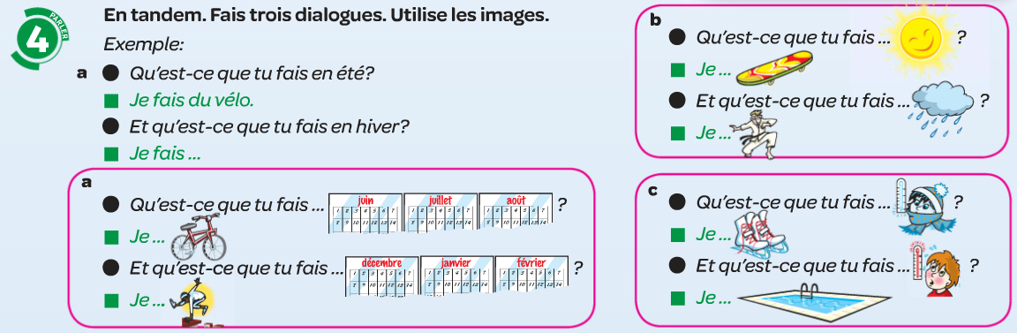
KESKA!
Challenge
These conversations are level 2.
Can you make them level 4? Practise until they’re fluent!
Challenge +
Can you make up your OWN lv 4 dialogues without using the book? Practise until it’s fluent!

Slide 8
français
To achieve this, we’re going to:
Identify some activities which use the verb “faire”
Understand people talking about what they do.
Form some conversations about activities in different weather.
We are learning about:
Qu’est-ce que tu fais?
what do you do?
We are learning to:
Say what we do in different weather conditions
with opinions – Lv3
with reasons – Lv4
Self-manager
Independent Enquirer
Effective Participator
Team Worker
PLTS: This lesson we are going to be:
Team Worker
Creative Thinker
Effective Participator
Creative Thinker
Reflective Learner
Notes:
8
8

Slide 9
Write out these sentences. Each letter stands for a word,
e.g. Q i f b, j f d p.
Quand il fait beau, je fais des promenades.
1) Q i p, j f d j.
2) Q i f f, j f d l n.
3) E h, j f d p a g.
4) E e, j f d l e.
Quand il pleut, je fais du judo
Quand il fait froid, je fais de la natation.
En hiver, je fais du patin à glace.
En été, je fais de l’équitation.

