Slide 1
What would happen if animals were round?
http://www.youtube.com/watch?v=yltlJEdSAHw
Where is the maths?
Watch the clip - Write down where you think the maths is.
How much can you find?

Slide 2
Pixar - Where is the maths?

Slide 3
Starter help -
Plot the points on your axis.
Complete the rectangle
Write down the coordinates for the final corner.
Extra Hot Starter

Slide 4
Plotting Line Graphs
Level 6
Learning Outcomes
I can complete a table of values (5b)
I can plot and draw vertical and horizontal
functions (5a)
I can plot and draw any simple
function (6a)

Slide 5
Substitution
Calculate the value of y in each of the following:
y = 5x when x = 6
y = x + 7 when x = 8
y = 3x – 5 when x = 10
y = 2x when x = 5
y = x + 10 when x = 7
y = 2x when x = -3
y = x – 6 when x = 13
y = 2x + 1 when x = 4

Slide 6
Now you try..
1) When x = 5 find
y = 3x + 2
y = 5x – 2
y = 4x + 7
2) When x = 7 find
y = 3x + 2
y = 5x – 2
y = 4x + 7
Extension
3) When x = -2 find
y = x + 7
y = x – 1
y = 3x + 4

Slide 7
Literacy
To plot the line y = x + 2, I need some
co-ordinates
To get the co-ordinates, I use a table of values
To find y, I substitute in values of x

Slide 8
Plotting Line Graphs
x | -2 | -1 | 0 | 1 | 2
y
0
1
2
3
4
For the line y = x + 2
When x = -2
y = -2 + 2
y = 0
When x = -1
y = -1 + 2
y = 1
When x = 0
y = 0 + 2
y = 2

Slide 9
Plotting Line Graphs
x | -2 | -1 | 0 | 1 | 2
y
Co-ordinates
0
1
2
3
4
(-2, 0)
(-1, 1)
(0, 2)
(1, 3)
(2, 4)
Now we have some co-ordinates, we can plot them to draw the line!

Slide 10
y
y = x + 2
5
4
X
3
X
X
2
X
1
X
X
-5
-4
-3
-2
-1
0
1
2
3
4
5
-1
-2
-3
x | -2 | -1 | 0 | 1 | 2
y
Co-ordinates
0
1
2
3
4
-4
(-2, 0)
(-1, 1)
(0, 2)
(1, 3)
(2, 4)
-5

Slide 11
Plotting Line Graphs
Choose your level - complete the questions.
Draw all lines with a ruler!
Label your axis and graph.

Slide 12
Review
By completing the table of values and drawing your own axis choose one of the following
Plot the graph for x = 5 and the graph for y = 3 (L5a)
Plot the graph for y = x + 3 (L6c)
Plot the graph for y = 2x -3 (L6b)
Plot the graph for y = 10 - 2x (L6a)
x | -2 | -1 | 0 | 1 | 2
y

Slide 13
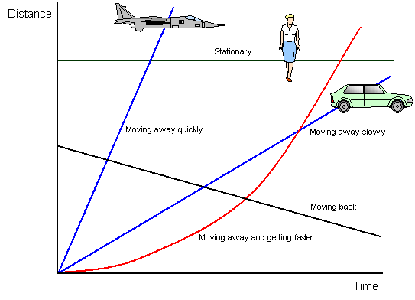
Plenary
Possible Application
Often in video games, computers have to work out whether objects ‘collide’
For example, trying to hit a ball with a baseball bat
Or trying to fire a shot at another player
How might the computer do this?
Both players can be modelled as coordinates
Based on the angle of the shot, the computer will calculate the equation of the line
It will then check whether the equation intersects with the second coordinate
If it does, then the computer knows there was a ‘hit’

Slide 14
Plenary
In reality, this is inaccurate, as each player occupies a range of coordinates rather than just one
What designers then did was to model each player as a circle
A circle has an equation which could look like this
(x – 4)² + (y + 1)² = 30
→ The computer will then effectively check whether the circle equation and the line equation have any ‘common coordinates’
Both players can be modelled as coordinates
Based on the angle of the shot, the computer will calculate the equation of the line
It will then check whether the equation intersects with the second coordinate
If it does, then the computer knows there was a ‘hit’

