Slide 1
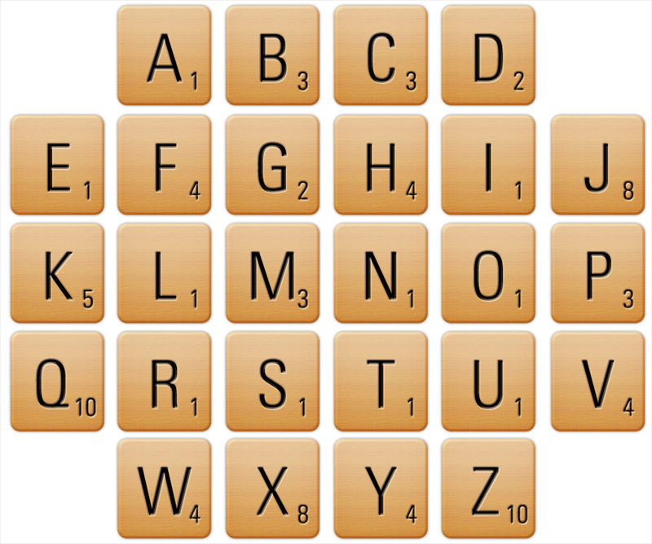
Can you come up with a key word for the lesson? How many points does it score?
Can you think of a word to do with the lesson objective?

