Slide 1
Tarsia Challenge
Please cut out the triangles.
Match the questions with the answers.
What level/ year group should be confident doing these questions?

Slide 2
Numeracy across the curriculum
Using Numeracy to
support teaching
Using teaching to
support Numeracy

Slide 3
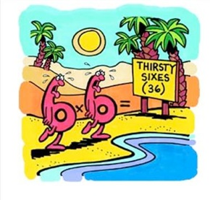
Level 1 – Be able to calculate
Level 2 – Be able to calculate efficiently
Level 3 – Be able to recall
Level 4 – Be able to apply with confidence
Level 5 – Be able to teach and support

Slide 4
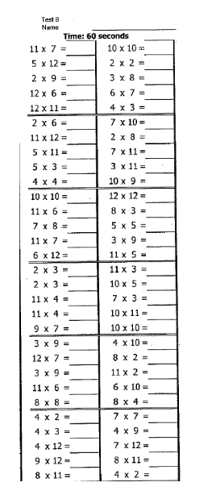
60 in 60 form challenge
60 questions
60 seconds
Twice a half term.
1 House Points for highest (in each year group).
2 House points for most improved.
Pupils keep records in their form files.

Slide 5
White Weekly Challenge

Slide 6
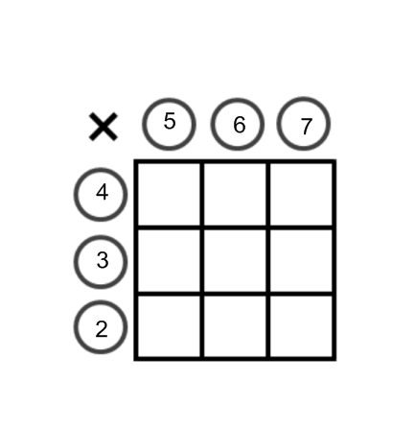

Slide 7
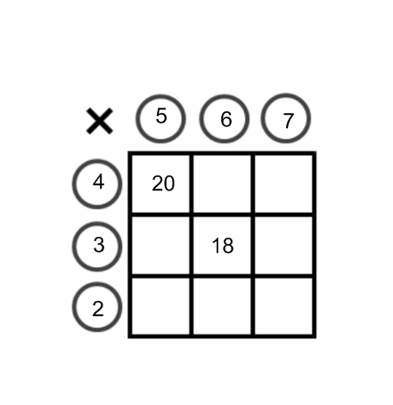

Slide 8
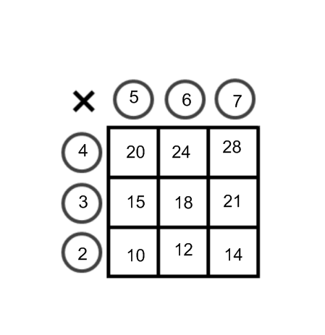
162

Slide 9
162
Possible extensions – Make the lowest number
- use a negative number
- decimals
- fractions

Slide 10
Online Resources
Tutpup Tutpup.com – brilliant for phones
Mymaths log in Burton password radius. Grid games.
Transum Table masters
ipads/ ipods – Math Duel App

Slide 11
Prepare Activities/ Brain Breaks
Fizz, Buzz. Cricket Fizz Buzz, Combined Fizz Buzz
11’s, 33’s, 77’s etc
Countdown
Broken Calculator
Missing Multipliers

