Slide 1
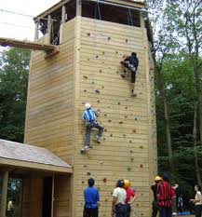
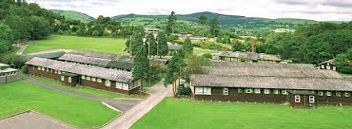
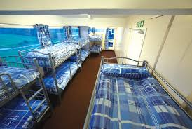
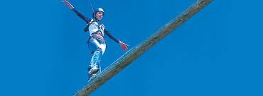
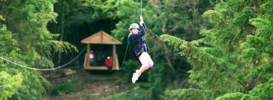
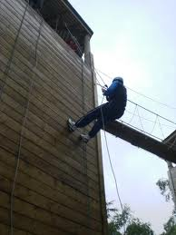
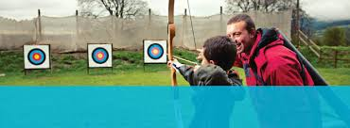
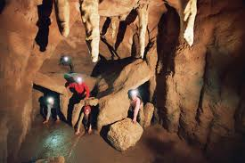
Extreme Numeracy
clip
Colomendy 2013

Slide 2
Who and Why

Slide 3
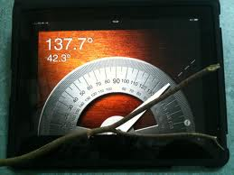
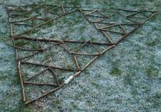
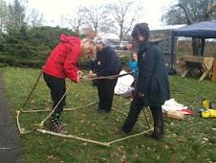
Numeracy Session
Active learning
1:1 support throughout
Core number skills
Fun

Slide 4
Extreme Activities
Developing trust
Building confidence
Having fun
Overcoming fears

Slide 5
Friday
 | Activity | Group Q | Group R
14:00 - 15:35 | Numeracy session | Mazes and proof |  | Making number sums with fingers (no sums)
15:50 - 17:00 | Active session | Settle and Site tour
17:05 - 18:15 | Meal Time
18:15 - 19:25 | Activity | Abseiling | Problem Solving
19:45 - 21:00 | Activity | Scraphead challenge
21:15 - 22:30 | Numeracy session | Making tetrahedrons with balloons

Slide 6
Saturday
9:30 - 10:40 | Numeracy session | extending number square - giant - addition / subtraction |  | Making number sums - just tens
10:50 - 12:00 | Activity | Giant Zip Wire | Abseiling
12:05 - 13:15 | Lunch
13:15 - 14:25 | Numeracy session | Catapult averages |  | making number sums - just digits
14:25 - 15:35 | Activity | Problem Solving | Giant Zip Wire
15:50 - 17:00 | Numeracy session | Multiplication murder mystery |  | making number sums - whole answer
17:05 - 18:15 | Meal time
18:15 - 19:25 | Activity | Leap of faith | Archery
19:45 - 21:00 | Activity | mini olympics
21:15 - 22:30 | Numeracy session | Making Sierpinski Pyramid – balloon modelling

Slide 7
Sunday
9:30 - 10:40 | Activity | Caving
10:50 - 12:00 | Activity | Archery | Leap of faith
12:05 - 13:15 | Lunch
13:15 - 14:25 | Numeracy session | Awards ceremony - next step commitments |  | making number sums - whole answers

Slide 8
Item List
Things you’ll need:
• Toiletries etc (please note deodorants must be
roll-on, no aerosols).
• Old clothes for activity sessions – (long-sleeved shirts, trousers and closed-toe shoes are required for nearly all sessions so bring plenty.) Clothes shoes and underwear for other times.
Plenty of spares – check (but don’t rely on) Weather report
• Waterproof clothing (jacket, trousers and
wellingtons).
• Large plastic bag for dirty clothes.
• A bath towel.
• Sunglasses, sun cream and hat in summer.
• Gloves, hat and scarf in winter.
• Pyjamas and slippers.
• A named water bottle (essential in summer).

Slide 9
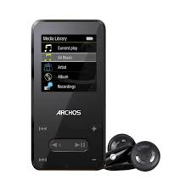
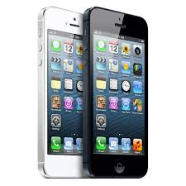
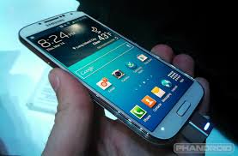
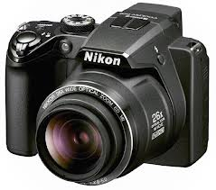
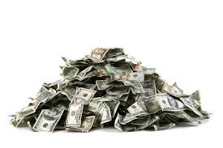
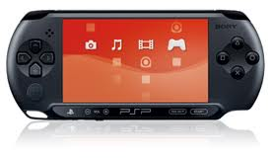
Things you won’t need
All items are taken at your own risk!!!

Slide 10
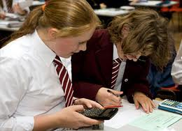
The small print
There’s no such thing as a free lunch.
Year 7 payment – Mathletics
Year 9 payment – Teaching support
Have Fun !!!!!!!

Slide 11
Dietary / Medical requirements

