Slide 1
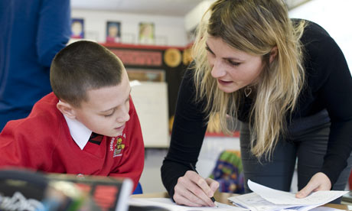
Division Master Class Learning Mentors
10 min
Objective – To be able to divide decimals by a whole number using short division
Activity 1 – times table puzzle (hint - there are 2 answers that are 60)

Slide 2
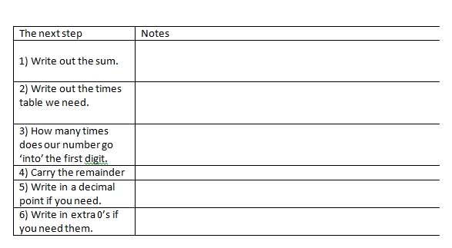
Steps to success

Slide 3
Completing Short division
186 ÷ 3 =
224 ÷ 4 =
196 ÷ 7 =
3159 ÷ 13 =
36601 ÷ 17 =
10 min

Slide 4
Collect a Joke
10 min
START | 231 | 928 | 427 | 912
354 ÷ 6 | 2532 ÷ 6 | FINISH | 432 ÷ 8 | 2784 ÷ 3
What’s the | between a | pants. | the | just
68 | 422 | 65 | 59 | 54
1281 ÷ 3 | 715 ÷ 11 | 272 ÷ 4 | 1617 ÷ 7 | 5472 ÷ 6
wears trousers, | Shepard and | his dog? One | difference | other

Slide 5
Dividing with decimals
912 ÷ 20 =
510 ÷ 8 =
36018 ÷ 12 =
314.7 ÷ 6 =
218.64 ÷ 14 =
1051.56 ÷ 23 =
10 min

Slide 6
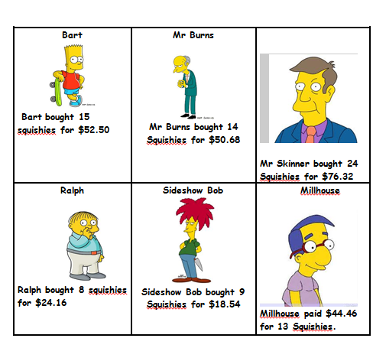
15 min

Slide 7
