Slide 2
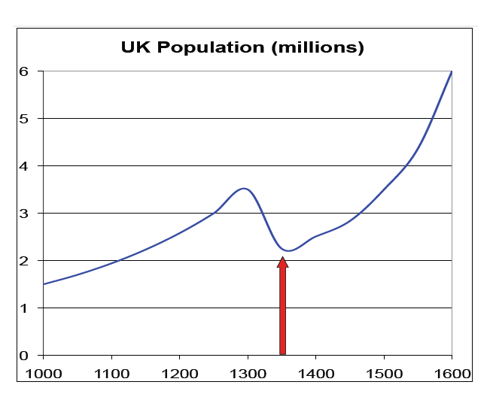
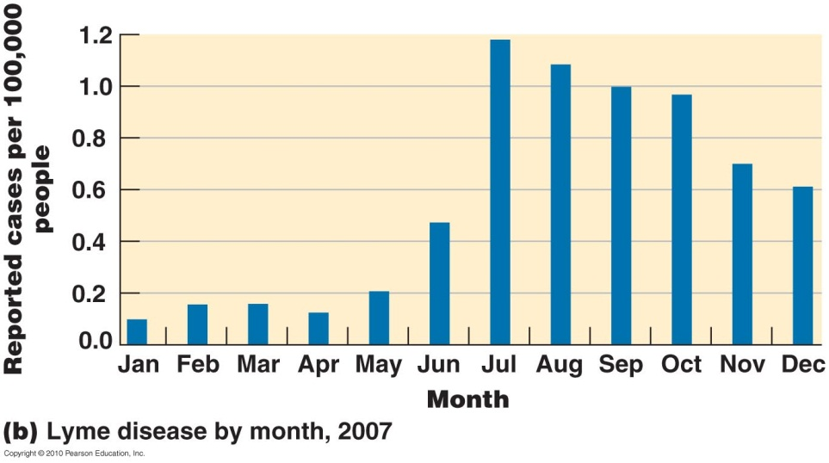

Slide 3
Video interruption

Slide 4
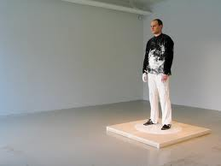
Mathematical Modelling
Investigation 1 – Stand up disease
Stand up disease is a simple disease
Main symptom is that you
cannot sit or lie down,
you just have to stand.

Slide 5
Stand up Disease
Step 1 – One infection
Step 2 – Infected person chooses two more people to be infected
Step 3 – Each infected person chooses 2 new people to be infected
Question – Each steps takes a minute.
How long to infect the class?

Slide 6
Stand up Disease
Step 1 – One infection
Step 2 – Infected person chooses two more people to be infected
Step 3 – Each infected person chooses 2 more people to be infected
Question – Each steps takes a minute.
How long to infect the class?

Slide 7
Stand up Disease
Feedback – what have we learned?
What patterns have we found?
Can we communicate our findings mathematically?

Slide 8
Interruption

Slide 9
26 Card Disease
Start with 26 Red Cards and 26 Black cards
The pile of red cards represents your
‘population’, you must always have 26 cards in
this pile.
Black cards represent people that have
become immune

Slide 10
26 Card Disease
Step 1 – Take the top card of the population pack and turn it face up.
Place a black card in your population pack to replace
the one you have just put down

Slide 11
26 Card Disease
Step 2–Without looking shuffle your population pack, take the top 2 cards and place them on the table.
If either of the cards are black
they represent an immune person
Put them back in the pack leaving a
Space on the table
Replace any red cards so that your
population pack has 26 cards in it

Slide 12
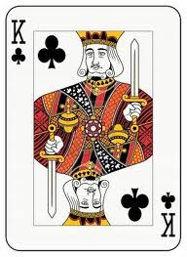
26 Card Disease
Step 3–Looking now only at the cards from the previous step – lay down 2 cards for every infected person.
If either of the cards are black
they represent an immune person
Put them back in the pack leaving a
Space on the table
Replace any red cards so that your
population pack has 26 cards in it

Slide 13
26 Card Disease
Run and record a few trials.
(you will have to split jobs up here)
What improvements could you
make to the model?
What if you started with some
People already immune?
Try a few examples and prepare to
share your findings
REMEMBER – if we don’t get this right
Were not going home!!!!

Slide 14
Closing
What skills have we developed that we would use in …
Other subjects
Maths
Other
Work
Home
Further
Education

