Slide 2
Introductions
Meet your table/ work partners

Slide 3
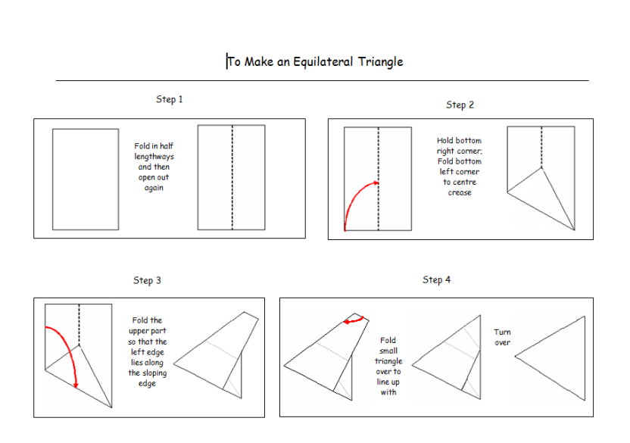
Code Names

Slide 4
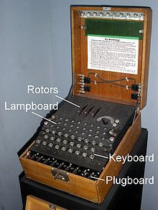
Why Codes and Ciphers
Inspire mathematicians of the future.
Leads into internet codes and security.
Prime numbers.
You will be able to make your own code.
Fun.

Slide 5
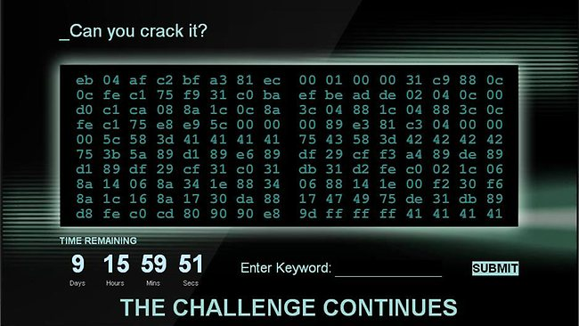
Open your files
Share the documents out.
Read them, explain them, understand them.
Make sure you ALL understand how each code works
Misinformation Alert
The Caesar Ciphers CAN have numbers, they just don’t need decoding.

Slide 6
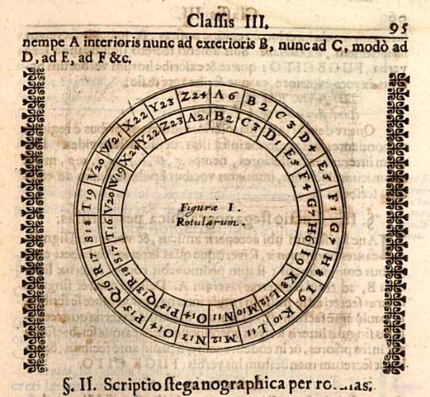
How does a cipher wheel work?
Set the code using the window in the inner disk
Try this one, set the wheel to code E and decode this message
wmdovdi dn vo rvm
What is the decoded message?
The possible codes for the task are
C, I, K, M, R, U or V
Good luck!

Slide 7
The Challenge
Each message is split into 7 parts.
Decode your part and stick it on the correct board.
Put the 7 parts into a statement to save your city.
You have exactly 10 minutes before your first city is destroyed, time will decrease with each task.
The team with the most Cities standing at the end wins.
Prioritise your tasks.

Slide 8
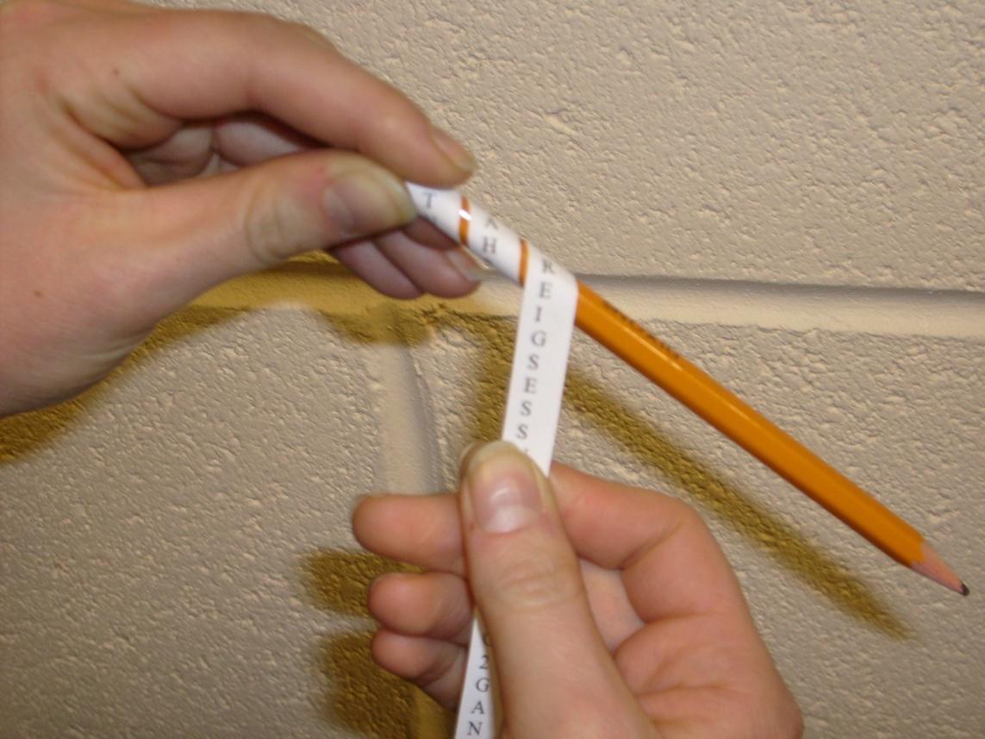
London
Pencil Code

Slide 9
Solution

Slide 10
This code was used 2500 years ago by the Spartans in ancient Greece
The big city of London will be bombed from the air more than 70 times
The city will be Blitzed from the 7th of September to the 10th of May
Civilians will take shelter from the raids in the subway stations
Tens of thousands of buildings will be destroyed to become rubble
London will eventually be bombed by the V1 pilotless flying bombs
By the end of world war 2 30000 Londoners will have lost their lives

Slide 11
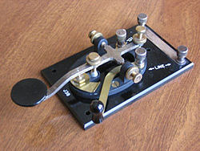
Liverpool
Morse Code

Slide 12
Solution

Slide 13
Liverpool, Bootle, and the Wirral will be the most heavily
bombed areas of the country outside of London, due to
their importance to the British war effort. The Winston Churchill was
desperate to hide from the Germans just how much damage
can be inflicted by targeting the docks, so reports on
the bombing will be kept very low-key. Over 4,000
residents of Liverpool will lose their lives during the blitz.

Slide 14
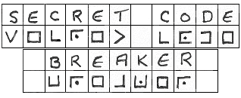
Coventry
Pig Pen

Slide 15
Solution

Slide 16
The biggest raid on the city of Coventry is planned
for the fourteenth of November. Coventry is a legitimate target
because it is an industrial city full of metal
work industries. There will be seventeen small raids carried out
by more than five hundred German bombers. The first wave
will drop high explosive bombs. These are designed to cause
massive disruption by knocking out the water and electricity supply.

Slide 17
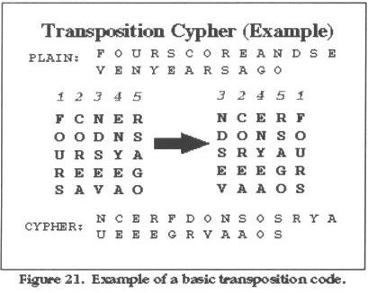
Southampton
Transposition
WRITTEN IN CAPITALS

Slide 18
Solution

Slide 19
T | H | I | S | P | O | R | T
C | I | T | Y | O | N | T | H
E | S | O | U | T | H | C | O
A | S | T | I | S | A | N | I
M | P | O | R | T | A | N | T
This port city on the south coast is an important
target. The fire from all the blitz bombings will
T | A | R | G | E | T | T | H
E | F | I | R | E | F | R | O
M | A | L | L | T | H | E | B
L | I | T | Z | B | O | M | B
I | N | G | S | W | I | L | L
be seen over the channel. Southampton will face a
Blitz on twenty third and thirtieth of November.
B | E | S | E | E | N | O | V
E | R | T | H | E | C | H | A
N | N | E | L | S | O | U | T
H | A | M | P | T | O | N | W
I | L | L | F | A | C | E | A
The docks and Woolstons Supermarine will be the
key target. Over 2 thousand bombs to be dropped on
Southampton during the course of this World War.

Slide 20
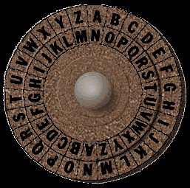
Birmingham
Shift (Caesar) Cipher

Slide 21
Solution

Slide 22
The Birmingham Small Arms Company turned itself over to
the war effort, becoming an important strategic target for the Luftwaffe.
The factory will be bombed several times, the worst air
raid being on 19 November 1940, causing loss of production
and trapping hundreds of workers. The net effect of the
November raids will be to destroy machine shops in the
four-storey 1915 building, the original gunsmiths' building and nearby buildings.

