Slide 1
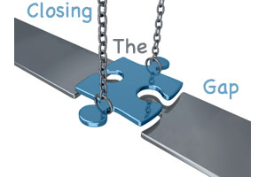
What is this piece?
What do we need to do to Close The Gap?

